Slide 1
Improved Access
Communications resource pack for GP practices in east Kent

Slide 2

Introduction
As part of a national drive to improve access to GP services, from 1 October 2018, everyone in east Kent (and around the UK) will be able to book an evening, weekend and bank holiday appointment with a GP, nurse and other health professionals.
As part of compliance, clusters and practices will need to demonstrate that they have appropriately and properly advertised their IA services.
This pack has been designed to give you some guidance around advertising content and provides useful resources to help you do this.

Slide 3
What do I need to do?
Make sure that:
The improved access services are advertised as widely as possible to patients.
This includes putting something up on your website, in your GP practice – so that it is clear to patients how they can access these appointments.
All practice staff are able to direct patients to the service and offer appointments in the evenings, at weekends and on bank holidays.

Slide 4
Advertising guidance

Slide 5
What we provide
Key information can be obtained from the guidance produced by NHS England’s national team. We won’t replicate that here, but merely signpost and add some additional information, and give you a useful structure
Read these slides in conjunction with the national guidance
National guidance: https://www.england.nhs.uk/wp-content/uploads/2017/09/improving-access-to-general-practice-guide-v2.pdf

Slide 6



In the practice
Make sure you have information on display about the Improved Access (IA) service. Don’t worry about being too specific about who is open when – simply make the message clear: We’re here for you, for longer
You can use a combination of posters, leaflets, your plasma screens, your PPG newsletters, banners or rolling screens
Make sure that receptionists offer all patients an option of an IA appointment as a matter of course
Discuss IA within patient meetings see your PPG for their help in promotion
Add some details/ hyperlink to practice staff email signatures
https://www.england.nhs.uk/wp-content/uploads/2017/09/10927329_14d2103_90x728.png

Slide 7
Materials available to help you tell your patients about the improved access service
Posters - to put up in your practice.
Lines for reception staff – to help direct patients to the service and offer them appointments .
Digital images for your practices’ website, for use on TV screens and for social media activity.
A story, announcing the new service, for you to publish on your website.
A short video that can also be published on your website.

Slide 8

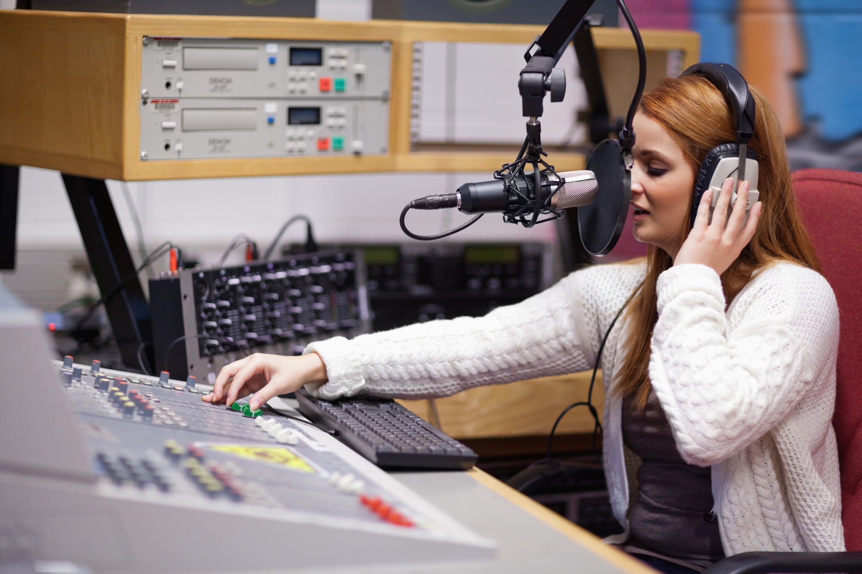
Help spread the word in your local area
Get some posters up in places where your patients are likely to see them. For example, community centres, pharmacies, libraries, etc.
If you wish you can locally arrange something in your local news media, take out an advert, or get them to do a story about the new service. This can be with local newspapers or radio.
Add details to the stickers that your pharmacies attach to prescription medication or your prescription labels.
Add a small graphic to your patient letters.

Slide 9
Lines for reception staff
Improved Access GP services (add to the care navigator script)
“From 1 October, we’ve now got more appointments in east Kent.
“I can book you in to see a doctor / nurse /other health care professional (depending on what the patient needs) after 6.30pm or at the weekend.
“It won’t necessarily be at this practice.
“Would you like me to take a look?”

Slide 10
Copy for GP practice websites
Extra appointments now available in east Kent
From 1 October, extra evening, weekend and bank holiday appointments are available in east Kent to help you get the care you need, when you need it.
This is part of a national drive to improve access to GP practice services and give people the opportunity to have an appointment at a time that suits them.
The extra appointments, which may be provided by a GP, nurse, physiotherapist, paramedic practitioner or other health professional, are for routine, non-urgent care. The extra slots are available between 6.30pm and 8pm each weekday. There are also appointments on Saturdays, Sundays and bank holidays.
They will not necessarily be at your usual GP practice, but the health professionals treating you will be able to see your full medical record, with your consent. If you need an appointment you will be allocated the most suitable clinician for your need.

Slide 11
Practice website
Make sure information is included
https://www.england.nhs.uk/wp-content/uploads/2017/09/10927329_9e2303_187x625_SIG.png
Make sure it is no more than two clicks from the homepage (a banner/ link on the homepage is good practice)
Ensure you’re optimised for accessibility and use on mobile devices

Slide 12



Social media
Make use of your usual social media routes to advertise your IA service
Facebook
Twitter
Instagram
WhatsApp
etc

Slide 13
Resources
NHS England National resources- communications guide and templates
  https://www.england.nhs.uk/gp/gpfv/redesign/improving-access/communications-guide/
More about audit
  http://www.uhbristol.nhs.uk/files/nhs-ubht/5%20How%20To%20Sample%20Data%20Collection%20and%20Form%20v3.pdf

